Slide 1

P4 Spring Workshop Topic Submission
Title: Table Driven Interface (TDI): Usages and Advantages |  |  | Contact: James Choi | BU:
Abstract: TDI provides both a local API and remote gRPC-based runtime specification that is P4 architecture independent, and usable for both P4 programmable and non-P4 fixed function management. This in-depth talk will cover overview of TDI, examples of usage with P4 PNA objects and DPDK non-P4 features, advantages that TDI provides for the control plane applications and device vendors, and the future direction.
Presenter Name(s) & Title(s): Sayan Bandyopadhyay, James Choi
Session Format: Please choose one of the following 4 options: | Moderated Talk Formats: Pre-recorded by ONF, and a member of the program committee will moderate each talk and engage with the speaker(s) in a short Q&A.
 | Tech Brief (5 minute presentation followed by 5 minute Q&A) | In-depth Talk (20 minute presentation followed by 10 minute Q&A)
 | Self-Recorded Submitted Content: Accepted pre-recorded talks must be recorded by the presenter and submitted as MP4 format 2 weeks prior to the event.
 | Demo (10+ minutes) | Educational Tutorials (60+ minutes)
Topics: highlight any topics that apply to your submission Compile Targets; Control plane, network OS for P4 targets; P4 language; P4 use cases and applications, Tool chain
Relevance: Recently open-sourced TDI has caught the interest of the P4 API development community as an API for IPDK(Infrastructure Programmer Development Kit). With wide interest of P4 as a customization tool, the flexibility of TDI makes it well-suited for broad adaptation by CSP’s. BFRT(Barefoot Runtime), the predecessor of TDI, is well known in the P4 community, and several CSPs and NOS providers already use it to integrate with their use cases. Broader community would be interested to know the direction this next generation is taking.
Intel Products: Tofino, Intel® IPU ES2000, P4 DPDK
Status of Project: TDI API is opensourced to p4lang (https://github.com/p4lang/tdi), and TDIRuntime spec is under development but not-yet open-sourced.
X

Slide 2
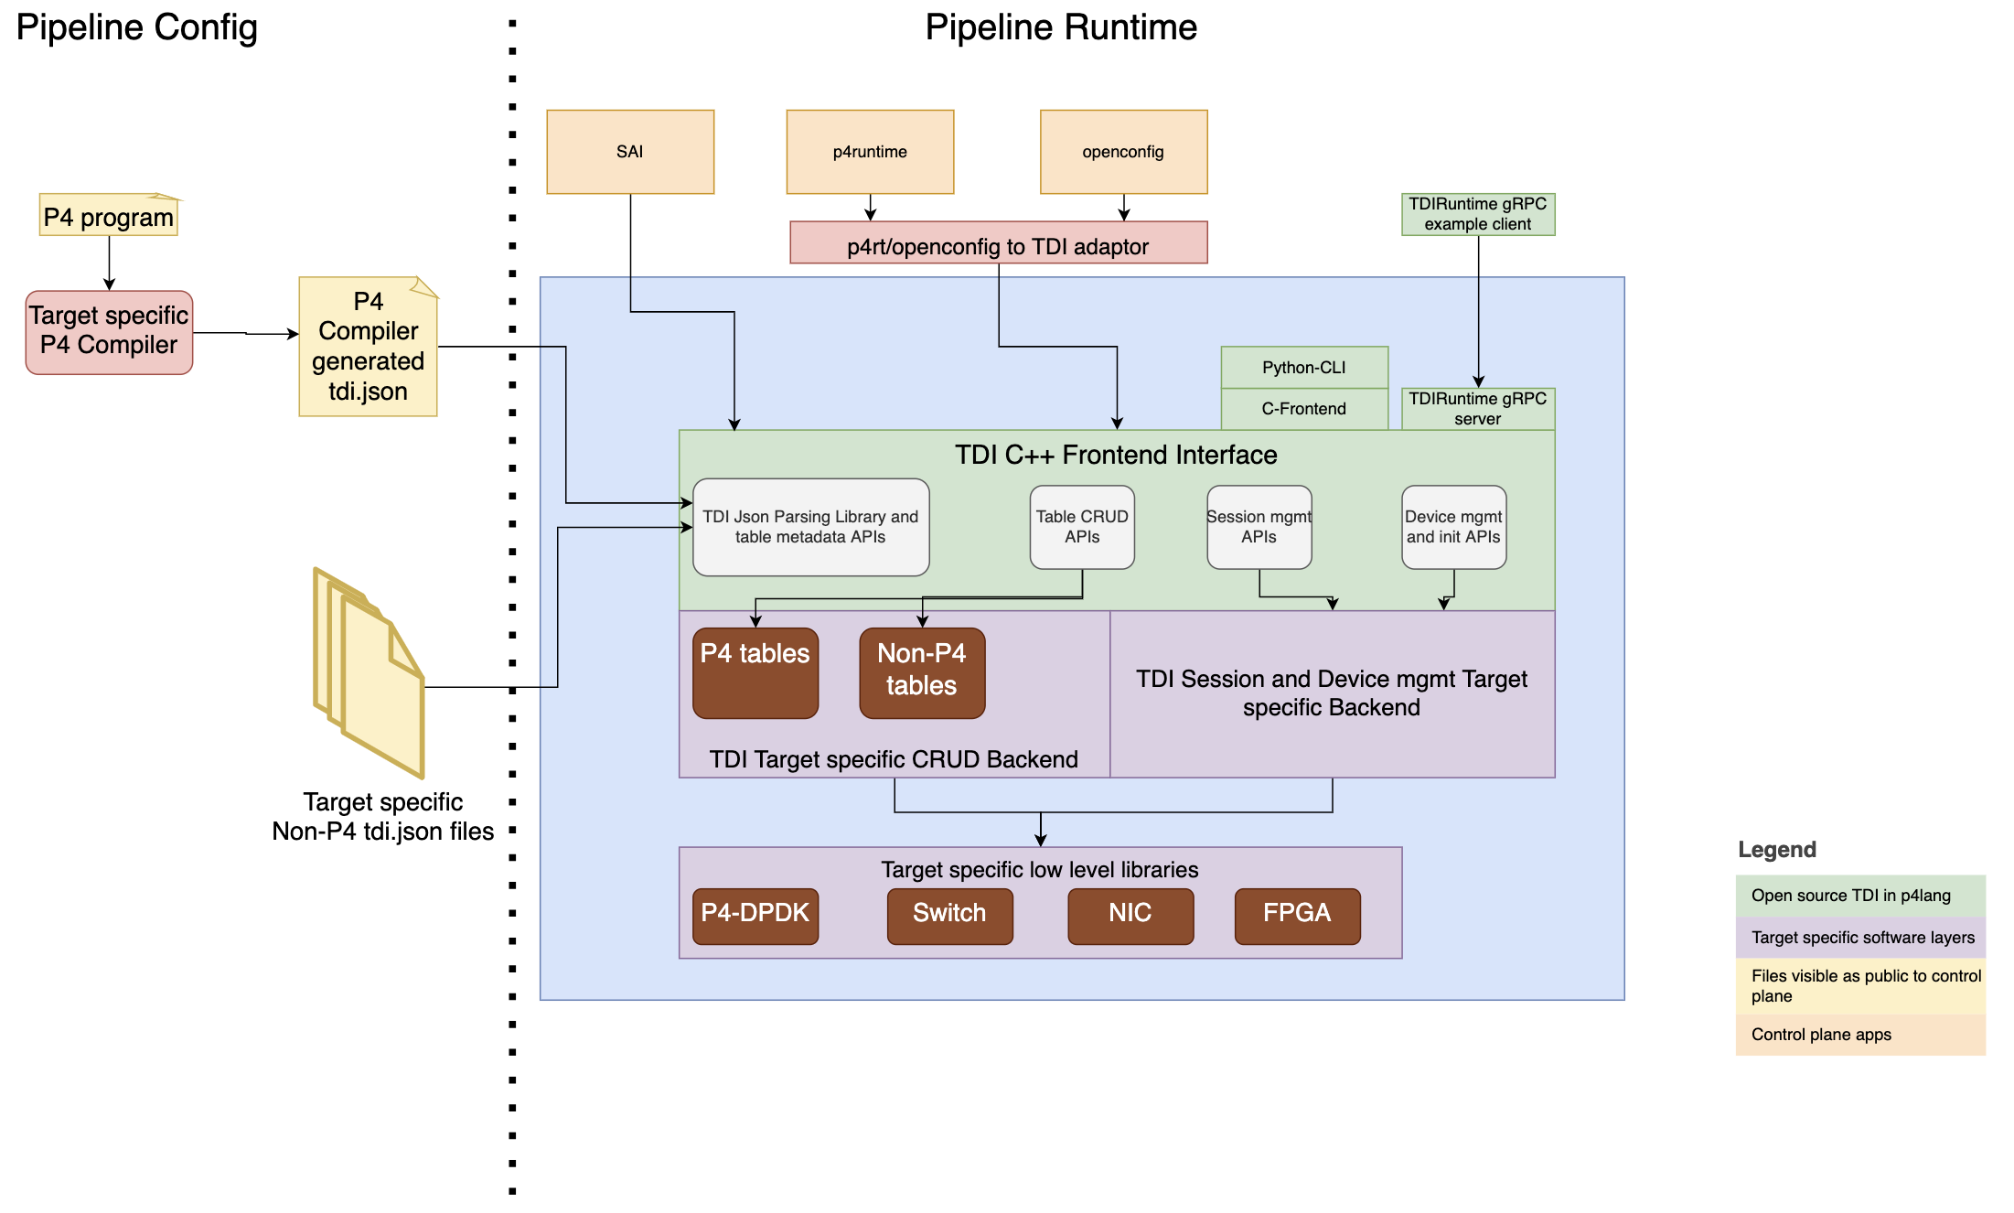
TDI: Overview & P4 DPDK Integration
TDI Overview will cover:
What is TDI?
Different public interfaces of TDI including C++, C-frontend, TDIRuntime, python CLI
TDI JSON table structure to API mapping and realization of a TDI table
P4 table/extern or non-P4 feature to TDI JSON table mapping
Advantages of using TDI over existing control plane API counterparts.
Roadmap
TDI Integration with P4 DPDK will cover:
The high-level SW architecture overview of the P4-DPDK-TARGET TDI implementation code.
TDI table implementations of P4 PNA architecture tables, P4 DPDK target only P4 features tables, and non-P4 features tables.
Usage of P4C compiler generated files in each layer.
Control plane integration with TDI API.
Pointers to example programs and instructions.

Slide 3
TDI: Overview
For TDI Overview part of presentation, we will cover:
What is TDI?
Different public interfaces of TDI including C++, C-frontend, TDIRuntime, python CLI
Different API groups – Init, metadata, Device mgmt, Table CRUD;
TDI JSON table structure to API mapping and realization of a TDI table
P4 table/extern or non-P4 feature to TDI JSON table mapping
Advantages of using TDI over existing control plane API counterparts.
Roadmap

Slide 4
TDI: Usage with P4-DPDK-TARGET
For TDI Usage part of presentation, we will cover:
The highlevel SW architecture overview of the TDI P4-DPDK-TARGET stack.
Layers of SW components and their functions.
Usage of P4C compiler generated files in each layer.
Control plane integration with TDI interface for P4 and non-P4 network functions.
Example TDI table implementation of a P4 PNA architecture constructs (e.g., action selector)
Example TDI table implementation of a P4 DPDK target specific constructs (e.g., lookup match table)
Example TDI table implementation of a non-P4 programmable feature (e.g. vdevice)
Discuss upcoming plans for supporting common P4 PNA architecture code.
Provide pointers to sample P4 files and instructions in the p4lang/p4-dpdk-target repo for P4 community to try out.

Slide 5
TDI: Usage with P4-DPDK-TARGET
For TDI Usage part of presentation, we will cover:
The highlevel SW architecture overview of the TDI P4-DPDK-TARGET stack.

